Slide 1
Financing universal health care in an ageing Philippines
Michael R.M. Abrigo
Philippine Institute for Development Studies

Slide 2
Background
The Philippines is a young population but ageing soon
Favorable economic conditions, including FDD, with fiscal reforms allowed government to allocate more resources to social services, including education and health
Free tertiary education
Universal health care
While human capital investments are important to benefit from SDD, there may be a need to temper government’s distribution of entitlements based on at least two grounds: fiscal sustainability and generational equity

Slide 3
How will population ageing affect the resource requirement to finance universal health care in the Philippines?

Slide 4
Key Takeaways
Population ageing has a direct and sizeable effect on government finances, which, in turn, affects households who finance government
Faster transition into ageing society may not necessarily lead to greater and more abrupt health care financing burden
Broadening the tax base to support government programs may decrease the burden on tax payers despite population ageing and even under generous government transfer regimes

Slide 5
UHC Law in the Philippines (2019)
Guarantees “equitable access to quality and affordable health care”
All Filipinos are automatically covered by the National Health Insurance Program (previously around 80% covered mainly through employment in formal sector and dependents of employed)
Subsidies for non-contributing members financed through general appropriation mainly from sin taxes (tobacco, alcohol, gambling, etc.)
Also provisions to improve health system: scholarship program, reorganization of health system, etc.

Slide 6
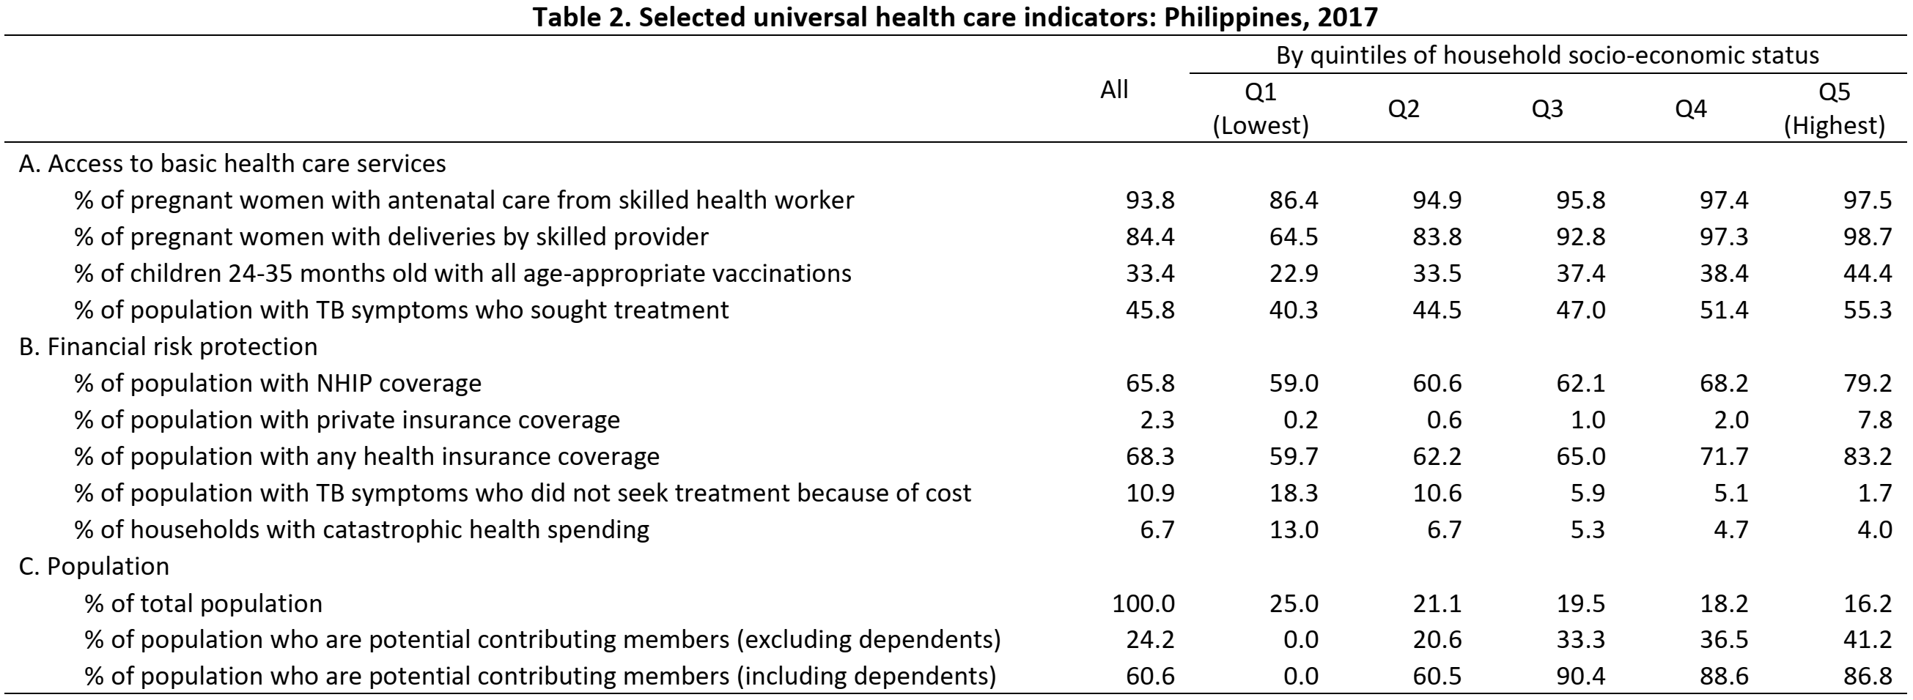
Who will benefit from UHC in the Philippines?

Slide 7
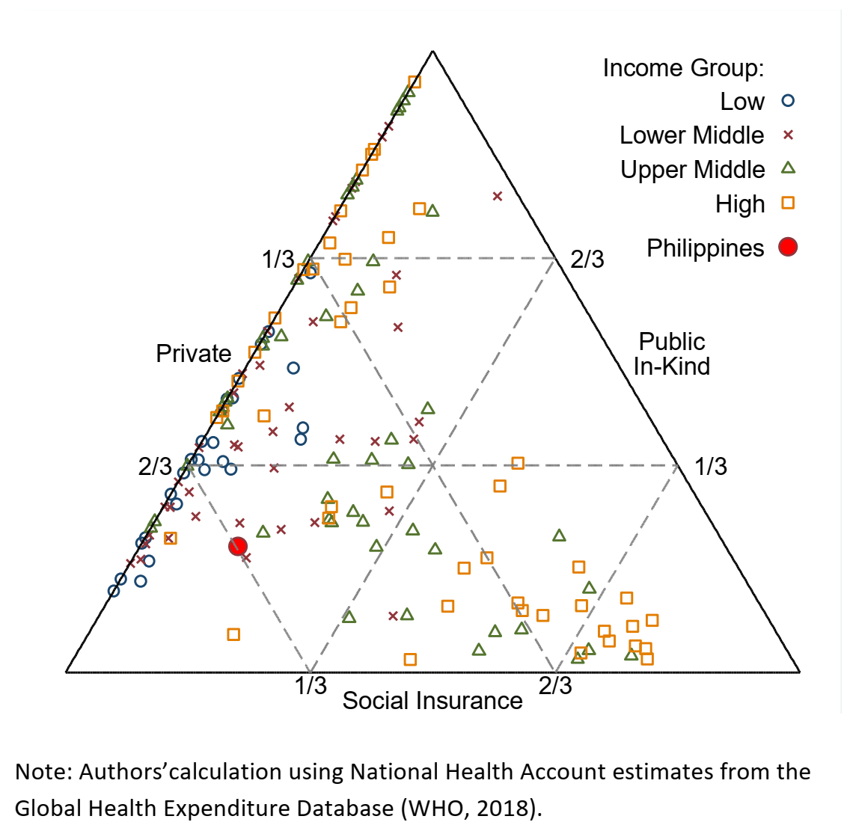
How is health care financed?
Tendency for greater public participation (in-kind or SHI) with higher income groups
Philippines: Largely private OOP similar to many low/lower middle income countries

Slide 8
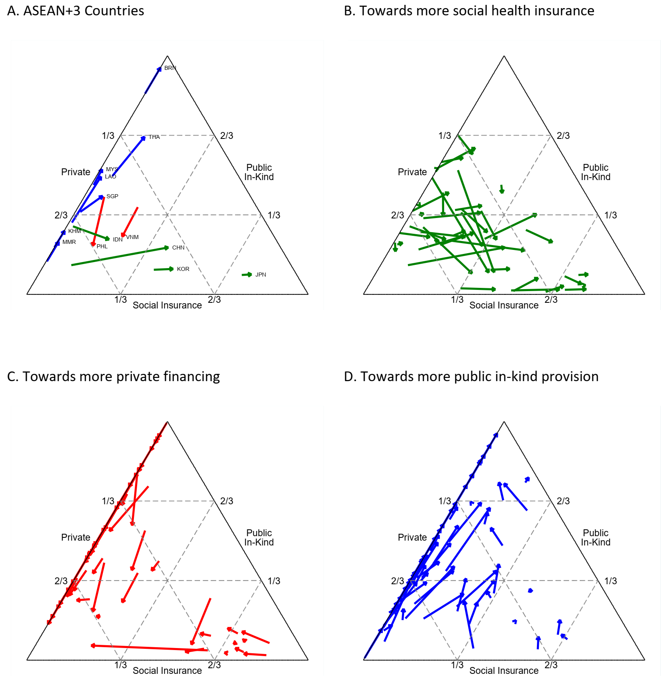
How is health care financed? A lot of changes between 2000 and 2015 around the world.

Slide 9
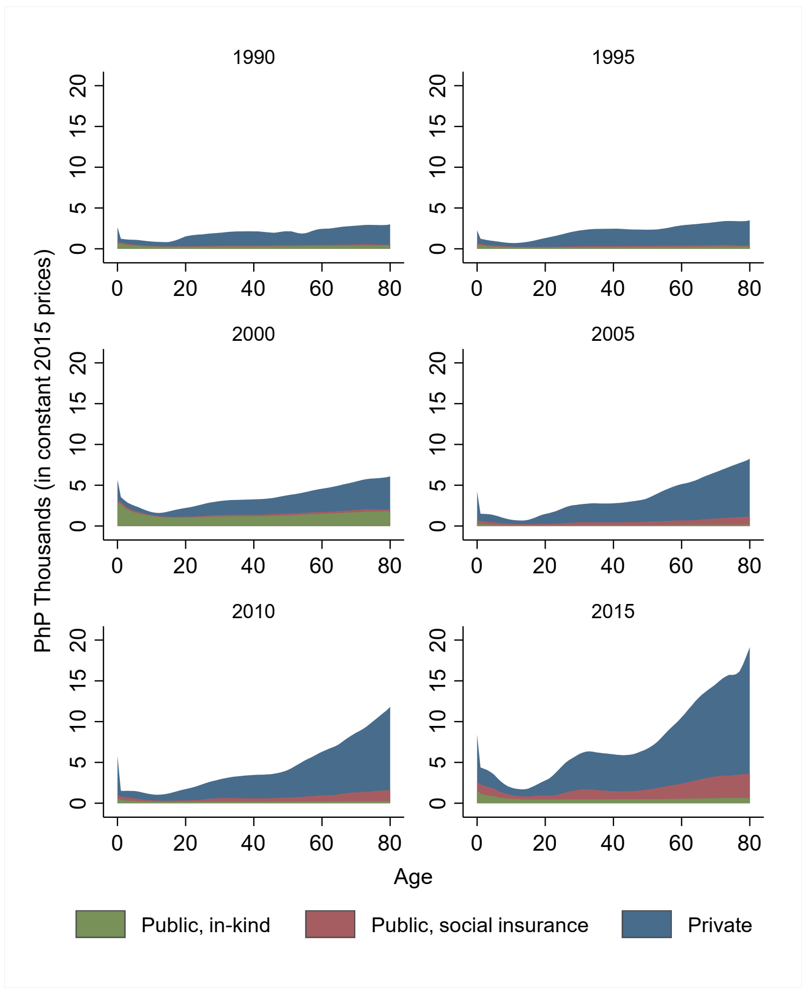
Health care consumption by age and source of financing: Philippines, 1990-2015
Expanding government expenditures, but faster growth in private expenditures

Slide 10
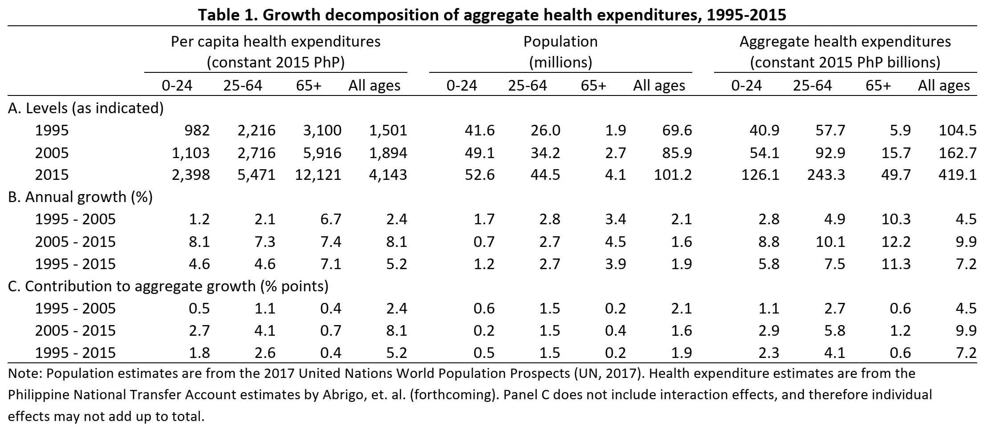
What drives aggregate health expenditure?

Slide 11
NTA-based Simulation
Goal: Project the contribution of changes in demography, government participation, longevity and tax base on burden of financing UHC
Some simplifications
Fixed per capita age profiles
Burden of disease remains the same
No technology change
No behavioral change
Essentially we are stuck with 2015 but with different people!
Useful first cut

Slide 12
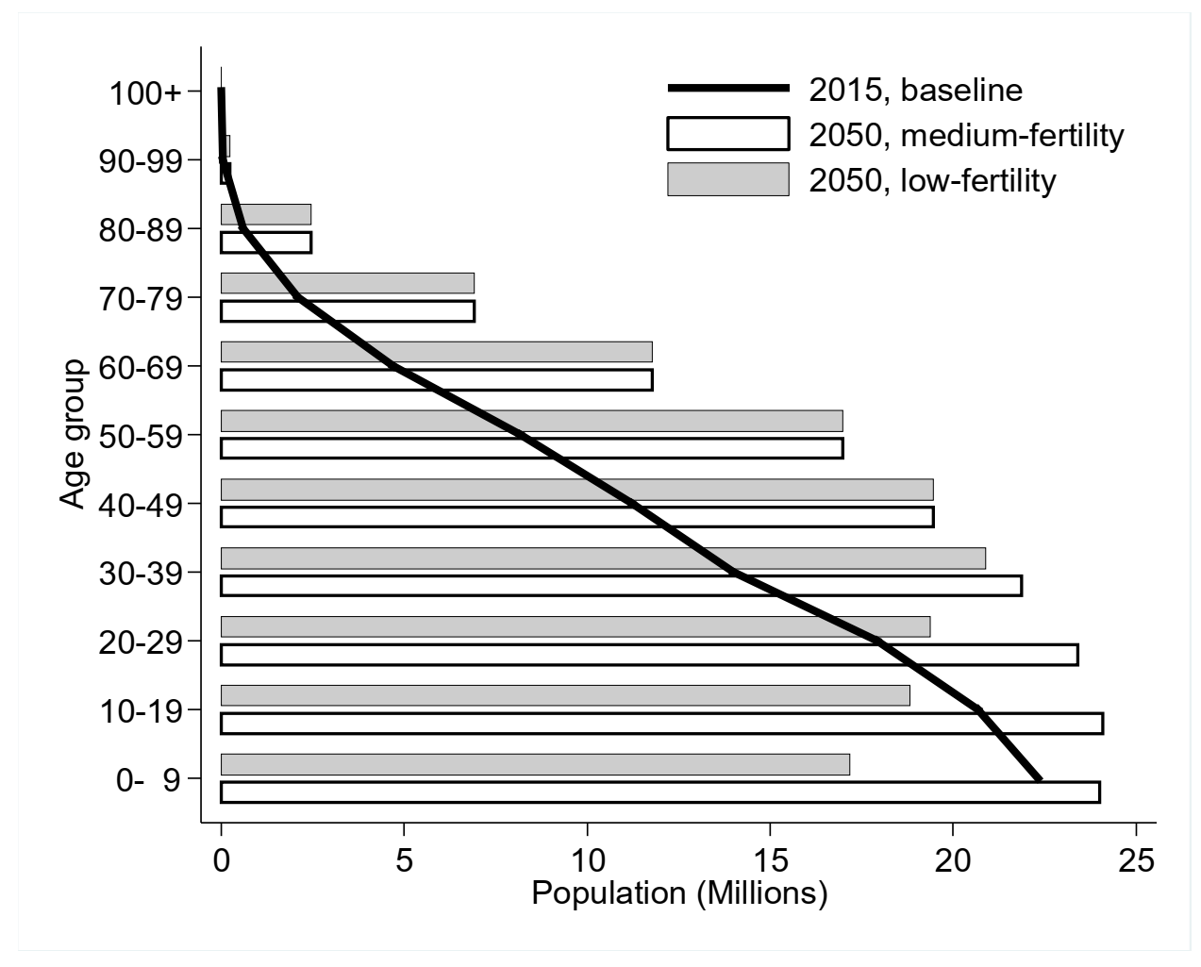
How will population change?
Two scenarios:
Ageing
Faster ageing
In both scenarios, ageing society by 2035, but less young and young adults by 2050 in low-fertility scenario

Slide 13
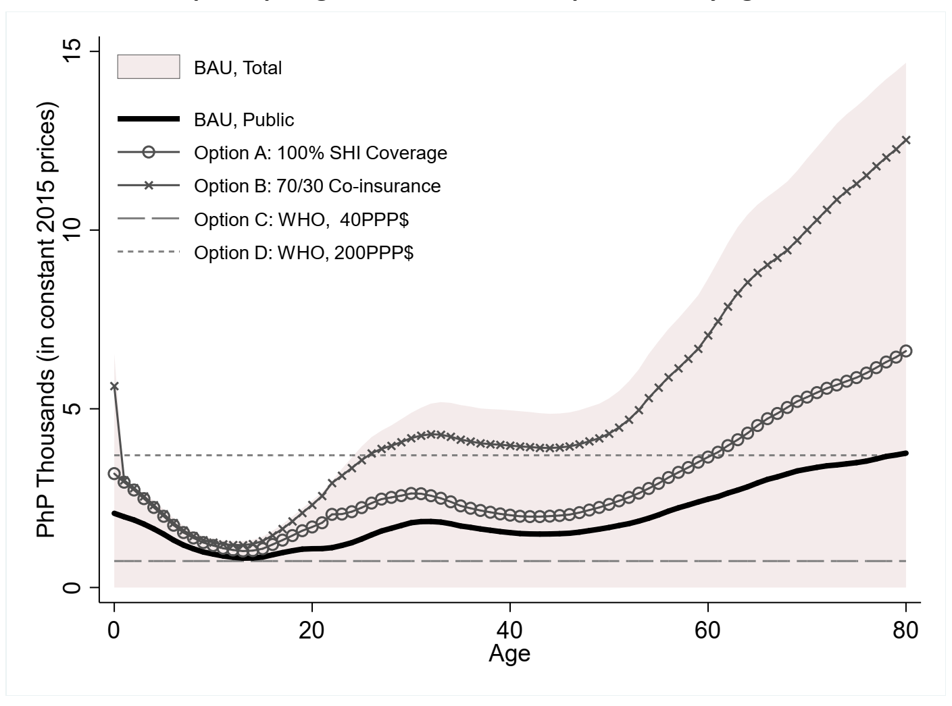
How generous is government?
Alternative public health consumption age profiles with (A) 100% SHI coverage, (B) plus 70/30 co-insurance for remaining OOP
For reference: WHO thresholds at (C) 40PPP$, and (D) 200PPP$

Slide 14
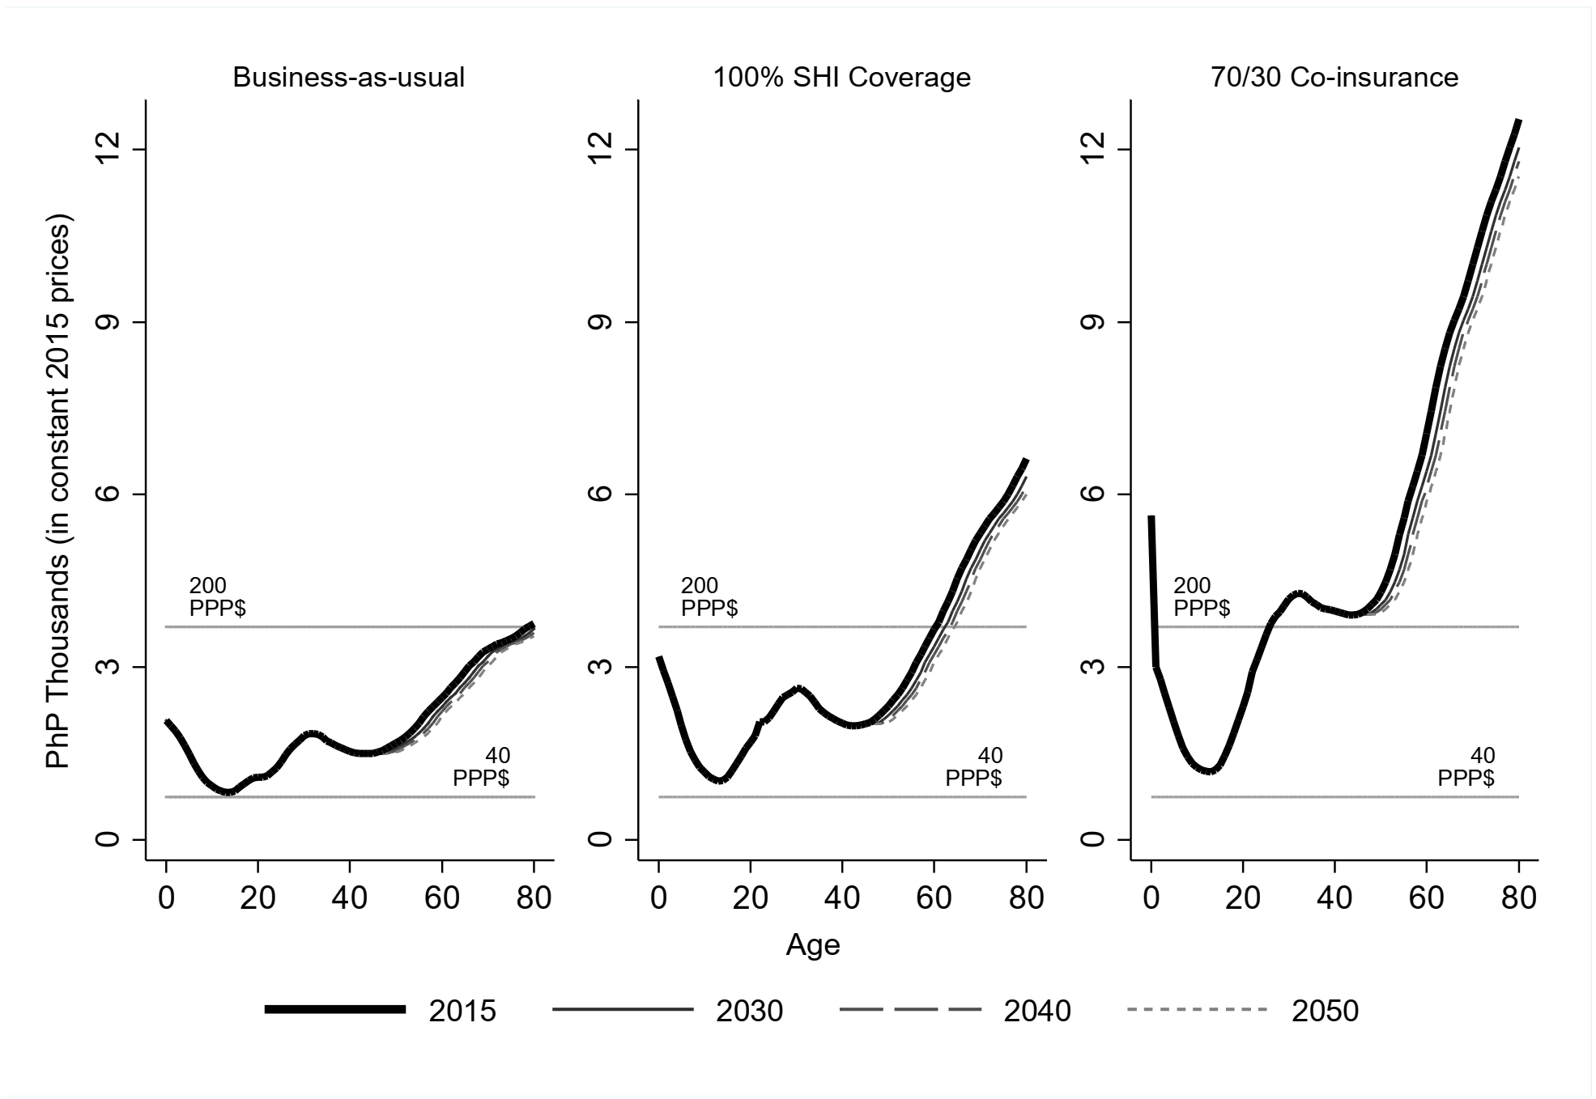
How is expenditure to change with longevity?
Much of health expenditures are in last few years of life

Slide 15
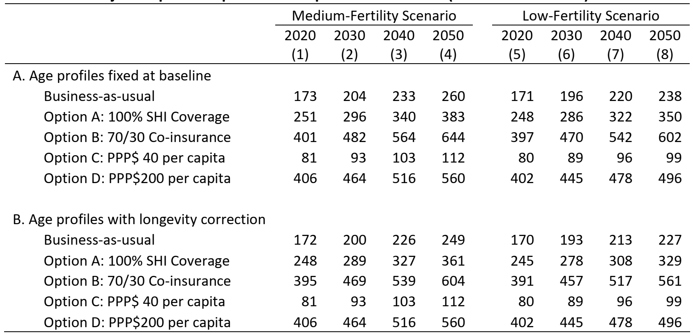
Results: How much will UHC cost? In PhP-B
Notes:
How much?
A lot! For reference PhP257
More generous offer, greater expenditure
Demographic change has substantial impact
But faster ageing does not necessarily lead to greater burden
WHO thresholds are good approximation but wide divergence for more advanced ageing
Observations hold even with longevity correction

Slide 16
How much will people need to pay? In %YL
Smaller tax rate with broader tax base even under faster ageing
For reference: Capped at 5% of labor income under UHC Law

Slide 17
Key Takeaways
Population ageing has a direct and sizeable effect on government finances, which, in turn, affects households who finance government
Faster transition into ageing society may not necessarily lead to greater and more abrupt health care financing burden
Broadening the tax base to support government programs may decrease the burden on tax payers despite population ageing and even under generous government transfer regimes

